Slide 1
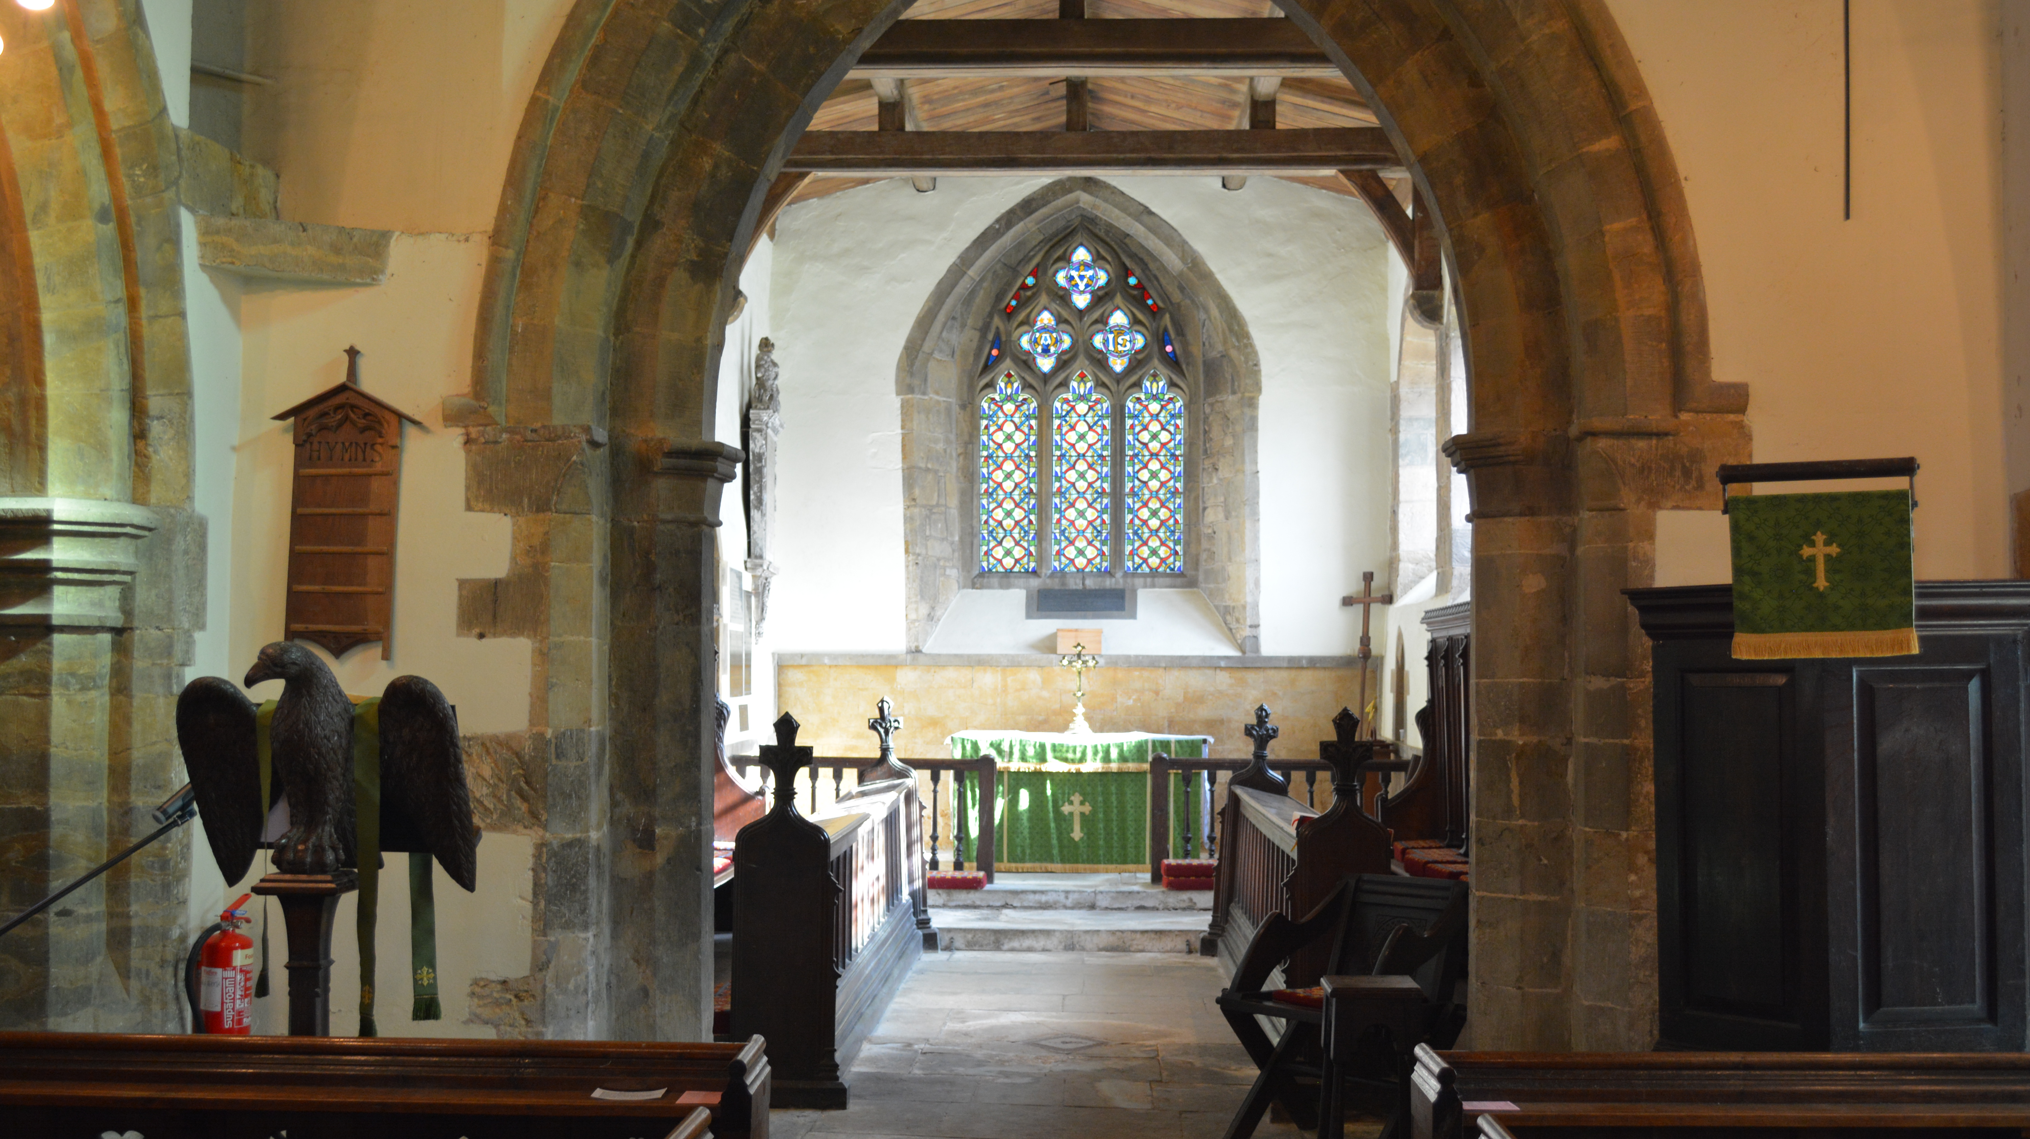
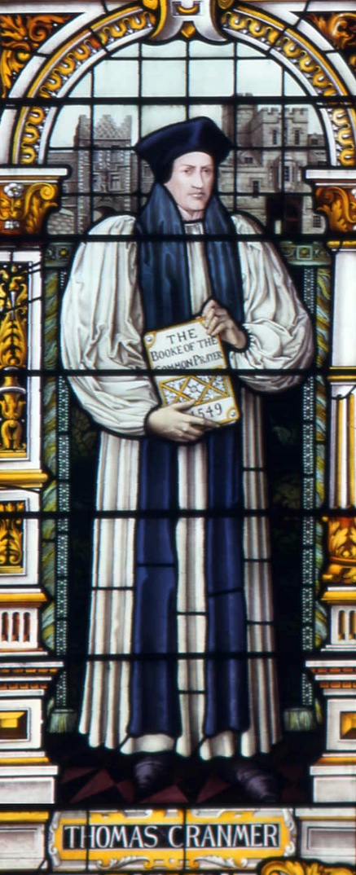
Traditional Language
Book of Common Prayer
HOLY COMMUNION
ST. PETER AND ST. CLARE
FENNY COMPTON

Slide 2
INTRODUCTION
Our Father which art in heaven,
Hallowed be thy Name,
Thy kingdom come, Thy will be done,
in earth as it is in heaven.
Give us this day our daily bread;
And forgive us our trespasses,
As we forgive them that trespass against us;
And lead us not into temptation,
But deliver us from evil.
All Amen.
PRAYER OF PREPARATION
All Almighty God,
unto whom all hearts be open, all desires known,
and from whom no secrets are hid:
Cleanse the thoughts of our hearts
by the inspiration of thy Holy Spirit,
that we may perfectly love thee,
and worthily magnify thy holy Name;
through Christ our Lord. Amen.

Slide 3
The Summary of the Law
Our Lord Jesus Christ said:
Hear, O Israel, the Lord our God is one Lord;
and thou shalt love the Lord thy God
with all thy heart, and with all thy soul,
and with all thy mind,
and with all thy strength.
This is the first commandment.
And the second is like, namely this;
Thou shalt love thy neighbour as thyself.
There is none other commandment greater than these.
On these two commandments hang all the law and the prophets.
All Lord, have mercy upon us,
and write all these thy laws in our hearts,
we beseech thee.

Slide 4
THE COLLECT
Let us pray for the Queen
Almighty God,
whose kingdom is ever-lasting, and power infinite:
Have mercy upon the whole Church;
and so rule the heart of thy chosen servant ELIZABETH,
our Queen and Governor,
that she (knowing whose minister she is)
may above all things seek thy honour and glory:
and that we and all her subjects
(duly considering whose authority she hath)
may faithfully serve, honour, and humbly obey her,
in thee, and for thee,
according to thy blessed Word and ordinance;
through Jesus Christ our Lord,
who with thee and the Holy Ghost
liveth and reigneth, ever one God, world without end.
All Amen.
COLLECT FOR THE DAY

Slide 5
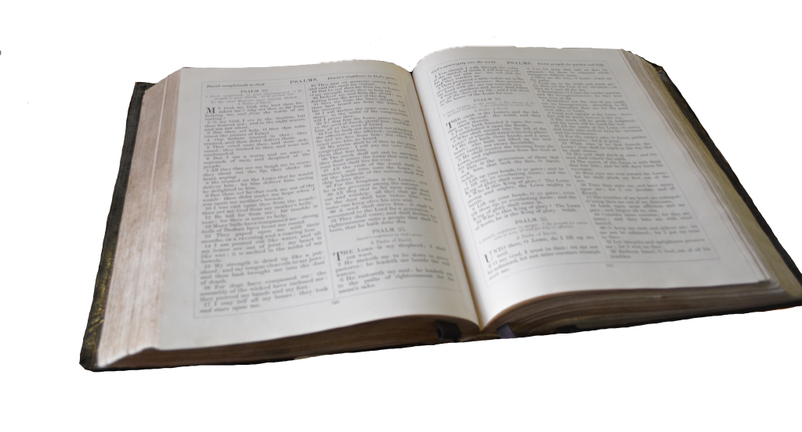
EPISTLE
GOSPEL
The Holy Gospel is written in the ______ chapter of the Gospel according to _____ beginning at the ____ verse.
All Glory be to thee, O Lord.
Ending with the words
This is the Gospel of the Lord
All Praise be to thee, O Christ.

Slide 6
THE CREED
All I believe in one God the Father Almighty,
Maker of heaven and earth,
And of all things visible and invisible:
And in one Lord Jesus Christ,
the only-begotten Son of God,
Begotten of his Father before all worlds,
God of God, Light of Light,
Very God of very God,
Begotten, not made,
Being of one substance with the Father,
By whom all things were made:
Who for us men and for our salvation
came down from heaven,
And was incarnate
by the Holy Ghost of the Virgin Mary,
And was made man,
And was crucified also for us under Pontius Pilate.

Slide 7
He suffered and was buried,
And the third day he rose again
according to the Scriptures,
And ascended into heaven,
And sitteth on the right hand of the Father.
And he shall come again with glory
to judge both the quick and the dead:
Whose kingdom shall have no end.
And I believe in the Holy Ghost,
The Lord and giver of life,
Who proceedeth from the Father and the Son,
Who with the Father and the Son
together is worshipped and glorified,
Who spake by the Prophets.
And I believe one Catholick and Apostolick Church.
I acknowledge one Baptism for the remission of sins.
And I look for the Resurrection of the dead,
And the life of the world to come. Amen.
SERMON

Slide 8
INTERCESSION
Let us pray for the whole state of Christ's Church militant here in earth.
Almighty and ever-living God, who by thy holy Apostle hast taught us to make prayers and supplications, and to give thanks, for all men: We humbly beseech thee most mercifully [*to accept our alms and oblations, and] to receive these our prayers, which we offer unto thy Divine Majesty; beseeching thee to inspire continually the universal Church with the spirit of truth, unity, and concord: And grant, that all they that do confess thy holy Name may agree in the truth of thy holy Word, and live in unity, and godly love.
We beseech thee also to save and defend all Christian Kings, Princes, and Governors; and specially thy servant ELIZABETH our Queen; that under her we may be godly and quietly governed: And grant unto her whole Council, and to all that are put in authority under her, that they may truly and indifferently minister justice, to the punishment of wickedness and vice, and to the maintenance of thy true religion, and virtue.

Slide 9
Give grace, O heavenly Father, to all Bishops and Curates, that they may both by their life and doctrine set forth thy true and lively Word, and rightly and duly administer thy holy Sacraments: And to all thy people give thy heavenly grace; and specially to this congregation here present; that, with meek heart and due reverence, they may hear, and receive thy holy Word; truly serving thee in holiness and righteousness all the days of their life.
MERCIFUL God, and heavenly Father, who hast taught us in thy holy Word that thou dost not willingly afflict or grieve the children of men; We most humbly beseech thee of thy goodness, O Lord, to comfort and succour all them, who in this transitory life are in trouble, sorrow, need, sickness, or any other adversity. Deliver us, we beseech thee, from our peril; give strength and skill to all those who minister to the sick; prosper the means made use of, for their cure; and grant that, perceiving how frail and uncertain our life is, we may apply our hearts unto that heavenly wisdom which leadeth to eternal life; through Jesus Christ our Lord.

Slide 10
And we also bless thy holy Name for all thy servants departed this life in thy faith and fear; beseeching thee to give us grace so to follow their good examples, that with them we may be partakers of thy heavenly kingdom:
Grant this, O Father, for Jesus Christ's sake, our only Mediator and Advocate.
All Amen.
INVITATION TO CONFESSION
Ye that do truly and earnestly repent you of your sins, and are in love and charity with your neighbours, and intend to lead a new life, following the commandments of God, and walking from henceforth in his holy ways: Draw near with faith, and take this holy Sacrament to your comfort; and make your humble confession to Almighty God, meekly kneeling upon your knees.

Slide 11
All Almighty God, Father of our Lord Jesus Christ,
maker of all things, judge of all men:
we acknowledge and bewail
our manifold sins and wickedness,
which we from time to time most grievously have
committed, by thought, word, and deed,
against thy Divine Majesty,
provoking most justly
thy wrath and indignation against us.
We do earnestly repent,
and are heartily sorry for these our misdoings;
The remembrance of them is grievous unto us;
The burden of them is intolerable.
Have mercy upon us,
have mercy upon us, most merciful Father;
for thy Son our Lord Jesus Christ's sake,
forgive us all that is past;
and grant that we may ever hereafter
serve and please thee in newness of life,
to the honour and glory of thy Name;
through Jesus Christ our Lord. Amen.

Slide 12
ABSOLUTION
Almighty God, our heavenly Father, who of his great mercy hath promised forgiveness of sins to all them that with hearty repentance and true faith turn unto him; have mercy upon you; pardon and deliver you from all your sins; confirm and strengthen you in all goodness; and bring you to everlastiing life; through Jesus Christ our Lord.
All Amen.
THE COMFORTABLE WORDS
Hear what comfortable words our Saviour Christ saith unto all that truly turn to him.
Come unto me all that travail and are heavy laden,
and I will refresh you.
Matthew 11.28
So God loved the world, that he gave his only-begotten Son,
to the end that all that believe in him should not perish,
but have everlasting life.
John 3.16

Slide 13
Hear also what Saint Paul saith:
This is a true saying, and worthy of all men to be received,
that Christ Jesus came into the world to save sinners.
1 Timothy 1.15
Hear what Saint John saith: If any man sin,
we have an advocate with the Father, Jesus Christ the righteous;
and he is the propitiation for our sins.
1 John 2.1
PREFACE
Lift up your heart. All We lift them up unto the Lord. Let us give thanks unto our Lord God. All It is meet and right so to do.
It is very meet, right, and our bounden duty,
that we should at all times, and in all places,
give thanks unto thee, O Lord, Holy Father,
almighty, everlasting God.

Slide 14
All Holy, holy, holy, Lord God of hosts,
heaven and earth are full of thy glory:
Glory be to thee, O Lord most High. Amen.
We do not presume to come to this thy Table, O merciful Lord,
trusting in our own righteousness, but in thy manifold and great mercies.
We are not worthy so much as to gather up the crumbs under thy Table.
But thou art the same Lord, whose property is always to have mercy:
Grant us therefore, gracious Lord,
so to eat the flesh of thy dear Son Jesus Christ,
and to drink his blood,
that our sinful bodies may be made clean by his body,
and our souls washed through his most precious blood,
and that we may evermore dwell in him, and he in us.
All Amen.

Slide 15
THE PRAYER OF CONSECRATION
Almighty God, our heavenly Father,who of thy tender mercy didst give thine only Son Jesus Christ to suffer death upon the cross for our redemption; who made there (by his one oblation of himself once offered) a full, perfect, and sufficient sacrifice, oblation, and satisfaction, for the sins of the whole world; and did institute, and in his holy Gospel command us to continue, a perpetual memory of that his precious death, until his coming again:
Hear us, O merciful Father, we most humbly beseech thee; and grant that we receiving these thy creatures of bread and wine, according to thy Son our Saviour Jesus Christ's holy institution, in remembrance of his death and passion, may be partakers of his most blessed Body and Blood: who, in the same night that he was betrayed, took Bread; and, when he had given thanks, he brake it, and gave it to his disciples, saying,
‘Take, eat; this is my Body which is given for you:
Do this in remembrance of me.'

Slide 16
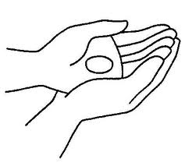
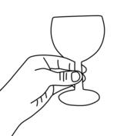
Likewise after supper he took the Cup; and, when he had given thanks, he gave it to them, saying,
'Drink ye all of this;
for this is my Blood of the New Testament,
which is shed for you and for many, for the remission of sins:
Do this, as oft as ye shall drink it, in remembrance of me.'
All Amen.
GIVING OF COMMUNION
The Body of our Lord Jesus Christ, which was given for thee, preserve thy body and soul unto everlasting life: Take and eat this in remembrance that Christ died for thee, and feed on him in thy heart by faith with thanksgiving.
The Blood of our Lord Jesus Christ, which was shed for thee, preserve thy body and soul unto everlasting life: Drink this in remembrance that Christ's Blood was shed for thee, and be thankful.

Slide 17
THE LORDS PRAYER
As our Saviour Christ hath commanded and taught us, we are bold to say:
All Our Father, which art in heaven,
Hallowed be thy Name,
Thy kingdom come,
Thy will be done,
in earth as it is in heaven.
Give us this day our daily bread;
And forgive us our trespasses,
As we forgive them that trespass against us;
And lead us not into temptation,
But deliver us from evil.
For thine is the kingdom,
the power, and the glory,
For ever and ever. Amen.

Slide 18
PRAYER AFTER COMMUNION
Almighty and ever-living God, we most heartily thank thee,
for that thou dost vouchsafe to feed us,
who have duly received these holy mysteries,
with the spiritual food of the most precious
Body and Blood of thy Son our Saviour Jesus Christ;
and dost assure us thereby of thy favour and goodness towards us;
and that we are very members incorporate in the mystical body
of thy Son,
which is the blessed company of all faithful people;
and are also heirs through hope of thy everlasting kingdom,
by the merits of the most precious death and passion of thy dear Son.
And we most humbly beseech thee, O heavenly Father,
so to assist us with thy grace,
that we may continue in that holy fellowship,
and do all such good works as thou hast prepared for us to walk in;
through Jesus Christ our Lord,
to whom, with thee and the Holy Ghost,
be all honour and glory, world without end.
All Amen.

Slide 19
GLORIA (Not in Lent or Advent)
All Glory be to God on high,
and in earth peace, good will towards men.
We praise thee, we bless thee, we worship thee,
we glorify thee, we give thanks to thee
for thy great glory, O Lord God, heavenly King,
God the Father Almighty.
O Lord, the only-begotten Son, Jesu Christ;
O Lord God, Lamb of God, Son of the Father,
that takest away the sins of the world,
have mercy upon us.
Thou that takest away the sins of the world,
have mercy upon us.
Thou that takest away the sins of the world,
receive our prayer.
Thou that sittest at the right hand of God the Father,,
have mercy upon us.

Slide 20
For thou only art holy;
thou only art the Lord;
thou only, O Christ, with the Holy Ghost,
art most high in the glory of God the Father. Amen.
THE BLESSING
The peace of God, which passeth all understanding,
keep your hearts and minds
in the knowledge and love of God,
and of his Son Jesus Christ our Lord:
And the blessing of God Almighty,
the Father, the Son, and the Holy Ghost,
be amongst you and remain with you always.
All Amen.

Slide 22
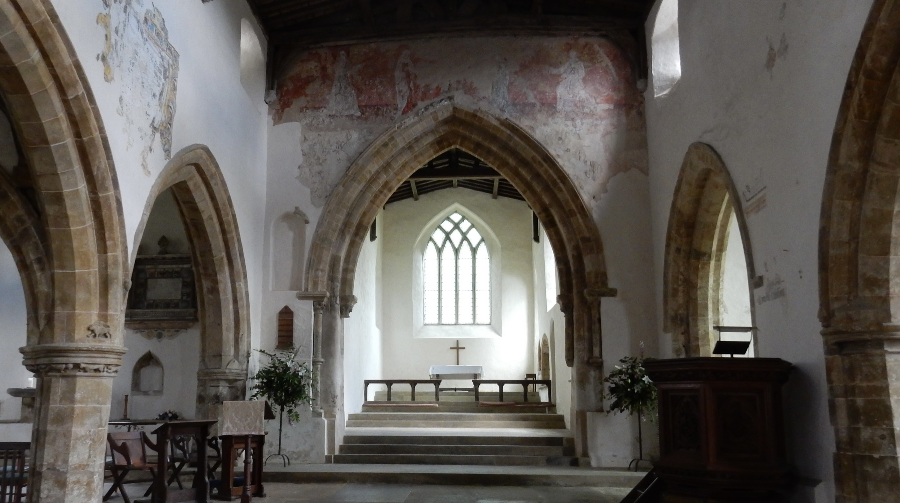
Traditional Language
Book of Common Prayer
HOLY COMMUNION
ALL SAINTS’
BURTON DASSETT

Slide 23
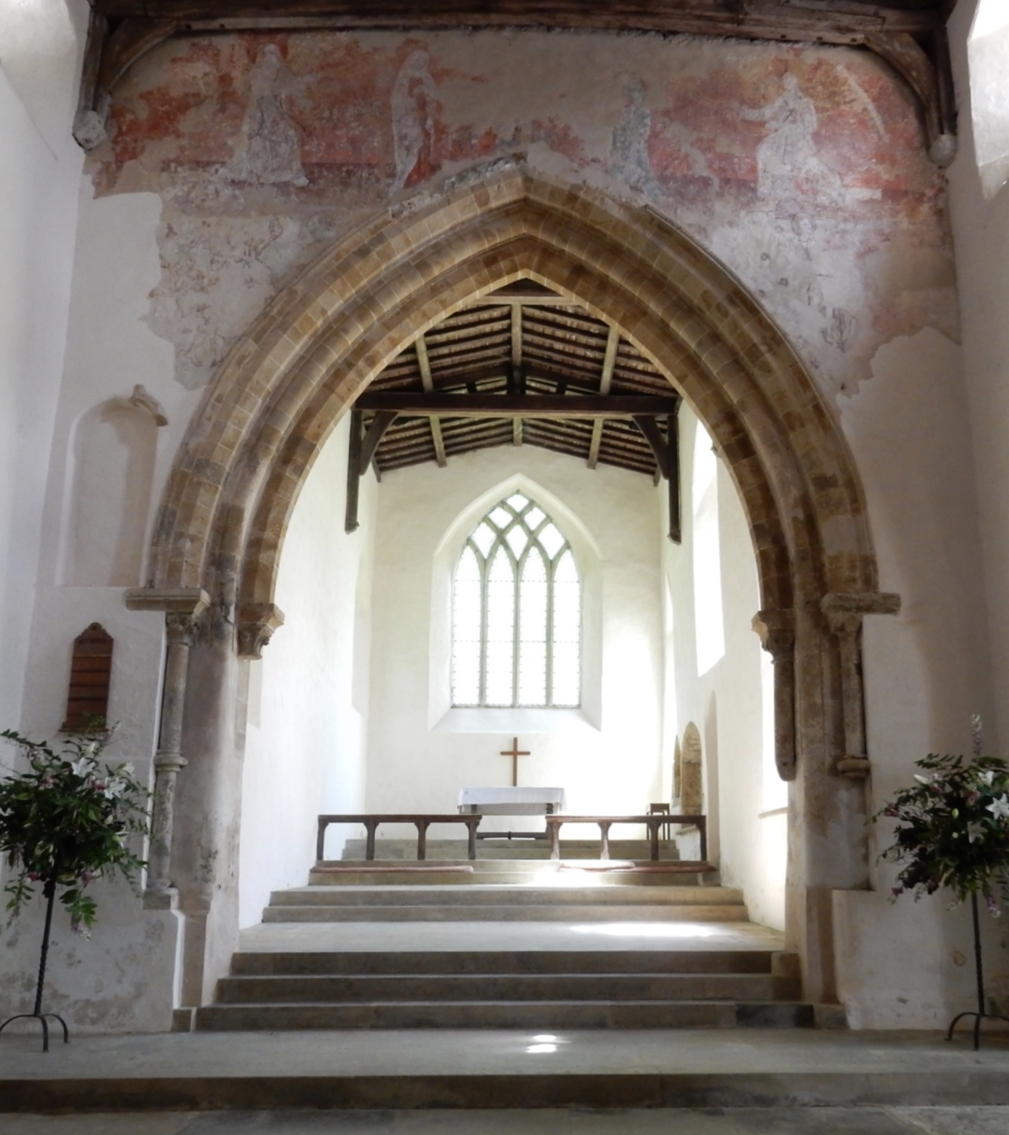
INTRODUCTION
Our Father which art in heaven,
Hallowed be thy Name,
Thy kingdom come, Thy will be done,
in earth as it is in heaven.
Give us this day our daily bread;
And forgive us our trespasses,
As we forgive them that trespass against us;
And lead us not into temptation,
But deliver us from evil.
All Amen.
PRAYER OF PREPARATION
All Almighty God,
unto whom all hearts be open, all desires known,
and from whom no secrets are hid:
Cleanse the thoughts of our hearts
by the inspiration of thy Holy Spirit,
that we may perfectly love thee,
and worthily magnify thy holy Name;
through Christ our Lord. Amen.

Slide 24
The Summary of the Law
Our Lord Jesus Christ said:
Hear, O Israel, the Lord our God is one Lord;
and thou shalt love the Lord thy God
with all thy heart, and with all thy soul,
and with all thy mind,
and with all thy strength.
This is the first commandment.
And the second is like, namely this;
Thou shalt love thy neighbour as thyself.
There is none other commandment greater than these.
On these two commandments hang all the law and the prophets.
All Lord, have mercy upon us,
and write all these thy laws in our hearts,
we beseech thee.

Slide 25
THE COLLECT
Let us pray for the Queen
Almighty God,
whose kingdom is ever-lasting, and power infinite:
Have mercy upon the whole Church;
and so rule the heart of thy chosen servant ELIZABETH,
our Queen and Governor,
that she (knowing whose minister she is)
may above all things seek thy honour and glory:
and that we and all her subjects
(duly considering whose authority she hath)
may faithfully serve, honour, and humbly obey her,
in thee, and for thee,
according to thy blessed Word and ordinance;
through Jesus Christ our Lord,
who with thee and the Holy Ghost
liveth and reigneth, ever one God, world without end.
All Amen.
COLLECT FOR THE DAY

Slide 26
EPISTLE
GOSPEL
The Holy Gospel is written in the ______ chapter of the Gospel according to _____ beginning at the ____ verse.
All Glory be to thee, O Lord.
Ending with the words
This is the Gospel of the Lord
All Praise be to thee, O Christ.

Slide 27
THE CREED
All I believe in one God the Father Almighty,
Maker of heaven and earth,
And of all things visible and invisible:
And in one Lord Jesus Christ,
the only-begotten Son of God,
Begotten of his Father before all worlds,
God of God, Light of Light,
Very God of very God,
Begotten, not made,
Being of one substance with the Father,
By whom all things were made:
Who for us men and for our salvation
came down from heaven,
And was incarnate
by the Holy Ghost of the Virgin Mary,
And was made man,
And was crucified also for us under Pontius Pilate.

Slide 28
He suffered and was buried,
And the third day he rose again
according to the Scriptures,
And ascended into heaven,
And sitteth on the right hand of the Father.
And he shall come again with glory
to judge both the quick and the dead:
Whose kingdom shall have no end.
And I believe in the Holy Ghost,
The Lord and giver of life,
Who proceedeth from the Father and the Son,
Who with the Father and the Son
together is worshipped and glorified,
Who spake by the Prophets.
And I believe one Catholick and Apostolick Church.
I acknowledge one Baptism for the remission of sins.
And I look for the Resurrection of the dead,
And the life of the world to come. Amen.
SERMON

Slide 29
INTERCESSION
Let us pray for the whole state of Christ's Church militant here in earth.
Almighty and ever-living God, who by thy holy Apostle hast taught us to make prayers and supplications, and to give thanks, for all men: We humbly beseech thee most mercifully [*to accept our alms and oblations, and] to receive these our prayers, which we offer unto thy Divine Majesty; beseeching thee to inspire continually the universal Church with the spirit of truth, unity, and concord: And grant, that all they that do confess thy holy Name may agree in the truth of thy holy Word, and live in unity, and godly love.
We beseech thee also to save and defend all Christian Kings, Princes, and Governors; and specially thy servant ELIZABETH our Queen; that under her we may be godly and quietly governed: And grant unto her whole Council, and to all that are put in authority under her, that they may truly and indifferently minister justice, to the punishment of wickedness and vice, and to the maintenance of thy true religion, and virtue.

Slide 30
Give grace, O heavenly Father, to all Bishops and Curates, that they may both by their life and doctrine set forth thy true and lively Word, and rightly and duly administer thy holy Sacraments: And to all thy people give thy heavenly grace; and specially to this congregation here present; that, with meek heart and due reverence, they may hear, and receive thy holy Word; truly serving thee in holiness and righteousness all the days of their life.
MERCIFUL God, and heavenly Father, who hast taught us in thy holy Word that thou dost not willingly afflict or grieve the children of men; We most humbly beseech thee of thy goodness, O Lord, to comfort and succour all them, who in this transitory life are in trouble, sorrow, need, sickness, or any other adversity. Deliver us, we beseech thee, from our peril; give strength and skill to all those who minister to the sick; prosper the means made use of, for their cure; and grant that, perceiving how frail and uncertain our life is, we may apply our hearts unto that heavenly wisdom which leadeth to eternal life; through Jesus Christ our Lord.

Slide 31
And we also bless thy holy Name for all thy servants departed this life in thy faith and fear; beseeching thee to give us grace so to follow their good examples, that with them we may be partakers of thy heavenly kingdom:
Grant this, O Father, for Jesus Christ's sake, our only Mediator and Advocate.
All Amen.
INVITATION TO CONFESSION
Ye that do truly and earnestly repent you of your sins, and are in love and charity with your neighbours, and intend to lead a new life, following the commandments of God, and walking from henceforth in his holy ways: Draw near with faith, and take this holy Sacrament to your comfort; and make your humble confession to Almighty God, meekly kneeling upon your knees.

Slide 32
All Almighty God, Father of our Lord Jesus Christ,
maker of all things, judge of all men:
we acknowledge and bewail
our manifold sins and wickedness,
which we from time to time most grievously have
committed, by thought, word, and deed,
against thy Divine Majesty,
provoking most justly
thy wrath and indignation against us.
We do earnestly repent,
and are heartily sorry for these our misdoings;
The remembrance of them is grievous unto us;
The burden of them is intolerable.
Have mercy upon us,
have mercy upon us, most merciful Father;
for thy Son our Lord Jesus Christ's sake,
forgive us all that is past;
and grant that we may ever hereafter
serve and please thee in newness of life,
to the honour and glory of thy Name;
through Jesus Christ our Lord. Amen.

Slide 33
ABSOLUTION
Almighty God, our heavenly Father, who of his great mercy hath promised forgiveness of sins to all them that with hearty repentance and true faith turn unto him; have mercy upon you; pardon and deliver you from all your sins; confirm and strengthen you in all goodness; and bring you to everlastiing life; through Jesus Christ our Lord.
All Amen.
THE COMFORTABLE WORDS
Hear what comfortable words our Saviour Christ saith unto all that truly turn to him.
Come unto me all that travail and are heavy laden,
and I will refresh you.
Matthew 11.28
So God loved the world, that he gave his only-begotten Son,
to the end that all that believe in him should not perish,
but have everlasting life.
John 3.16

Slide 34
Hear also what Saint Paul saith:
This is a true saying, and worthy of all men to be received,
that Christ Jesus came into the world to save sinners.
1 Timothy 1.15
Hear what Saint John saith: If any man sin,
we have an advocate with the Father, Jesus Christ the righteous;
and he is the propitiation for our sins.
1 John 2.1
PREFACE
Lift up your heart. All We lift them up unto the Lord. Let us give thanks unto our Lord God. All It is meet and right so to do.
It is very meet, right, and our bounden duty,
that we should at all times, and in all places,
give thanks unto thee, O Lord, Holy Father,
almighty, everlasting God.

Slide 35
All Holy, holy, holy, Lord God of hosts,
heaven and earth are full of thy glory:
Glory be to thee, O Lord most High. Amen.
We do not presume to come to this thy Table, O merciful Lord,
trusting in our own righteousness, but in thy manifold and great mercies.
We are not worthy so much as to gather up the crumbs under thy Table.
But thou art the same Lord, whose property is always to have mercy:
Grant us therefore, gracious Lord,
so to eat the flesh of thy dear Son Jesus Christ,
and to drink his blood,
that our sinful bodies may be made clean by his body,
and our souls washed through his most precious blood,
and that we may evermore dwell in him, and he in us.
All Amen.

Slide 36
THE PRAYER OF CONSECRATION
Almighty God, our heavenly Father,who of thy tender mercy didst give thine only Son Jesus Christ to suffer death upon the cross for our redemption; who made there (by his one oblation of himself once offered) a full, perfect, and sufficient sacrifice, oblation, and satisfaction, for the sins of the whole world; and did institute, and in his holy Gospel command us to continue, a perpetual memory of that his precious death, until his coming again:
Hear us, O merciful Father, we most humbly beseech thee; and grant that we receiving these thy creatures of bread and wine, according to thy Son our Saviour Jesus Christ's holy institution, in remembrance of his death and passion, may be partakers of his most blessed Body and Blood: who, in the same night that he was betrayed, took Bread; and, when he had given thanks, he brake it, and gave it to his disciples, saying,
‘Take, eat; this is my Body which is given for you:
Do this in remembrance of me.'

Slide 37
Likewise after supper he took the Cup; and, when he had given thanks, he gave it to them, saying,
'Drink ye all of this;
for this is my Blood of the New Testament,
which is shed for you and for many,
for the remission of sins:
Do this, as oft as ye shall drink it,
in remembrance of me.'
All Amen.
GIVING OF COMMUNION
The Body of our Lord Jesus Christ, which was given for thee, preserve thy body and soul unto everlasting life: Take and eat this in remembrance that Christ died for thee, and feed on him in thy heart by faith with thanksgiving.
The Blood of our Lord Jesus Christ, which was shed for thee, preserve thy body and soul unto everlasting life: Drink this in remembrance that Christ's Blood was
shed for thee, and be thankful.

Slide 38
THE LORDS PRAYER
As our Saviour Christ hath commanded and taught us, we are bold to say:
All Our Father, which art in heaven,
Hallowed be thy Name,
Thy kingdom come,
Thy will be done,
in earth as it is in heaven.
Give us this day our daily bread;
And forgive us our trespasses,
As we forgive them that trespass against us;
And lead us not into temptation,
But deliver us from evil.
For thine is the kingdom,
the power, and the glory,
For ever and ever. Amen.

Slide 39
PRAYER AFTER COMMUNION
Almighty and ever-living God, we most heartily thank thee,
for that thou dost vouchsafe to feed us,
who have duly received these holy mysteries,
with the spiritual food of the most precious
Body and Blood of thy Son our Saviour Jesus Christ;
and dost assure us thereby of thy favour and goodness towards us; and that we are very members incorporate in the mystical body of thy Son, which is the blessed company of all faithful people; and are also heirs through hope of thy everlasting kingdom, by the merits of the most precious death and passion of thy dear Son.
And we most humbly beseech thee, O heavenly Father,
so to assist us with thy grace,
that we may continue in that holy fellowship,
and do all such good works as thou hast prepared for us to walk in; through Jesus Christ our Lord,
to whom, with thee and the Holy Ghost,
be all honour and glory, world without end.
All Amen.

Slide 40
GLORIA (Not in Lent or Advent)
All Glory be to God on high,
and in earth peace, good will towards men.
We praise thee, we bless thee, we worship thee,
we glorify thee, we give thanks to thee
for thy great glory, O Lord God, heavenly King,
God the Father Almighty.
O Lord, the only-begotten Son, Jesu Christ;
O Lord God, Lamb of God, Son of the Father,
that takest away the sins of the world,
have mercy upon us.
Thou that takest away the sins of the world,
have mercy upon us.
Thou that takest away the sins of the world,
receive our prayer.
Thou that sittest at the right hand of God the Father,
have mercy upon us.

Slide 41
For thou only art holy;
thou only art the Lord;
thou only, O Christ, with the Holy Ghost,
art most high in the glory of God the Father. Amen.
THE BLESSING
The peace of God, which passeth all understanding,
keep your hearts and minds
in the knowledge and love of God,
and of his Son Jesus Christ our Lord:
And the blessing of God Almighty,
the Father, the Son, and the Holy Ghost,
be amongst you and remain with you always.
All Amen.

Slide 43
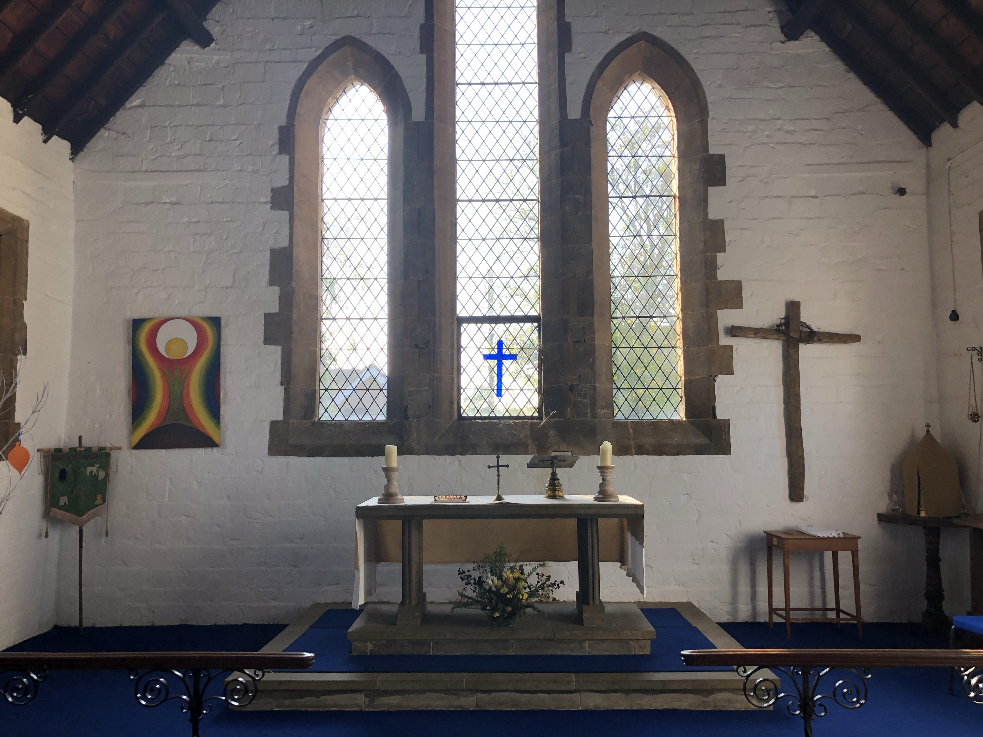
Traditional Language
Book of Common Prayer
HOLY COMMUNION
CHAPEL OF EASE
NORTHEND

Slide 44
INTRODUCTION
Our Father which art in heaven,
Hallowed be thy Name,
Thy kingdom come, Thy will be done,
in earth as it is in heaven.
Give us this day our daily bread;
And forgive us our trespasses,
As we forgive them that trespass against us;
And lead us not into temptation,
But deliver us from evil.
All Amen.
PRAYER OF PREPARATION
All Almighty God,
unto whom all hearts be open, all desires known,
and from whom no secrets are hid:
Cleanse the thoughts of our hearts
by the inspiration of thy Holy Spirit,
that we may perfectly love thee,
and worthily magnify thy holy Name;
through Christ our Lord. Amen.

Slide 45
The Summary of the Law
Our Lord Jesus Christ said:
Hear, O Israel, the Lord our God is one Lord;
and thou shalt love the Lord thy God
with all thy heart, and with all thy soul,
and with all thy mind,
and with all thy strength.
This is the first commandment.
And the second is like, namely this;
Thou shalt love thy neighbour as thyself.
There is none other commandment greater than these.
On these two commandments hang all the law and the prophets.
All Lord, have mercy upon us,
and write all these thy laws in our hearts,
we beseech thee.

Slide 46
THE COLLECT
Let us pray for the Queen
Almighty God,
whose kingdom is ever-lasting, and power infinite:
Have mercy upon the whole Church;
and so rule the heart of thy chosen servant ELIZABETH,
our Queen and Governor,
that she (knowing whose minister she is)
may above all things seek thy honour and glory:
and that we and all her subjects
(duly considering whose authority she hath)
may faithfully serve, honour, and humbly obey her,
in thee, and for thee,
according to thy blessed Word and ordinance;
through Jesus Christ our Lord,
who with thee and the Holy Ghost
liveth and reigneth, ever one God, world without end.
All Amen.
COLLECT FOR THE DAY

Slide 47
EPISTLE
GOSPEL
The Holy Gospel is written in the ______ chapter of the Gospel according to _____ beginning at the ____ verse.
All Glory be to thee, O Lord.
Ending with the words
This is the Gospel of the Lord
All Praise be to thee, O Christ.

Slide 48
THE CREED
All I believe in one God the Father Almighty,
Maker of heaven and earth,
And of all things visible and invisible:
And in one Lord Jesus Christ,
the only-begotten Son of God,
Begotten of his Father before all worlds,
God of God, Light of Light,
Very God of very God,
Begotten, not made,
Being of one substance with the Father,
By whom all things were made:
Who for us men and for our salvation
came down from heaven,
And was incarnate
by the Holy Ghost of the Virgin Mary,
And was made man,
And was crucified also for us under Pontius Pilate.

Slide 49
He suffered and was buried,
And the third day he rose again
according to the Scriptures,
And ascended into heaven,
And sitteth on the right hand of the Father.
And he shall come again with glory
to judge both the quick and the dead:
Whose kingdom shall have no end.
And I believe in the Holy Ghost,
The Lord and giver of life,
Who proceedeth from the Father and the Son,
Who with the Father and the Son
together is worshipped and glorified,
Who spake by the Prophets.
And I believe one Catholick and Apostolick Church.
I acknowledge one Baptism for the remission of sins.
And I look for the Resurrection of the dead,
And the life of the world to come. Amen.
SERMON

Slide 50
INTERCESSION
Let us pray for the whole state of Christ's Church militant here in earth.
Almighty and ever-living God, who by thy holy Apostle hast taught us to make prayers and supplications, and to give thanks, for all men: We humbly beseech thee most mercifully [*to accept our alms and oblations, and] to receive these our prayers, which we offer unto thy Divine Majesty; beseeching thee to inspire continually the universal Church with the spirit of truth, unity, and concord: And grant, that all they that do confess thy holy Name may agree in the truth of thy holy Word, and live in unity, and godly love.
We beseech thee also to save and defend all Christian Kings, Princes, and Governors; and specially thy servant ELIZABETH our Queen; that under her we may be godly and quietly governed: And grant unto her whole Council, and to all that are put in authority under her, that they may truly and indifferently minister justice, to the punishment of wickedness and vice, and to the maintenance of thy true religion, and virtue.

Slide 51
Give grace, O heavenly Father, to all Bishops and Curates, that they may both by their life and doctrine set forth thy true and lively Word, and rightly and duly administer thy holy Sacraments: And to all thy people give thy heavenly grace; and specially to this congregation here present; that, with meek heart and due reverence, they may hear, and receive thy holy Word; truly serving thee in holiness and righteousness all the days of their life.
MERCIFUL God, and heavenly Father, who hast taught us in thy holy Word that thou dost not willingly afflict or grieve the children of men; We most humbly beseech thee of thy goodness, O Lord, to comfort and succour all them, who in this transitory life are in trouble, sorrow, need, sickness, or any other adversity. Deliver us, we beseech thee, from our peril; give strength and skill to all those who minister to the sick; prosper the means made use of, for their cure; and grant that, perceiving how frail and uncertain our life is, we may apply our hearts unto that heavenly wisdom which leadeth to eternal life; through Jesus Christ our Lord.

Slide 52
And we also bless thy holy Name for all thy servants departed this life in thy faith and fear; beseeching thee to give us grace so to follow their good examples, that with them we may be partakers of thy heavenly kingdom:
Grant this, O Father, for Jesus Christ's sake, our only Mediator and Advocate.
All Amen.
INVITATION TO CONFESSION
Ye that do truly and earnestly repent you of your sins, and are in love and charity with your neighbours, and intend to lead a new life, following the commandments of God, and walking from henceforth in his holy ways: Draw near with faith, and take this holy Sacrament to your comfort; and make your humble confession to Almighty God, meekly kneeling upon your knees.

Slide 53
All Almighty God, Father of our Lord Jesus Christ,
maker of all things, judge of all men:
we acknowledge and bewail
our manifold sins and wickedness,
which we from time to time most grievously have
committed, by thought, word, and deed,
against thy Divine Majesty,
provoking most justly
thy wrath and indignation against us.
We do earnestly repent,
and are heartily sorry for these our misdoings;
The remembrance of them is grievous unto us;
The burden of them is intolerable.
Have mercy upon us,
have mercy upon us, most merciful Father;
for thy Son our Lord Jesus Christ's sake,
forgive us all that is past;
and grant that we may ever hereafter
serve and please thee in newness of life,
to the honour and glory of thy Name;
through Jesus Christ our Lord. Amen.

Slide 54
ABSOLUTION
Almighty God, our heavenly Father, who of his great mercy hath promised forgiveness of sins to all them that with hearty repentance and true faith turn unto him; have mercy upon you; pardon and deliver you from all your sins; confirm and strengthen you in all goodness; and bring you to everlastiing life; through Jesus Christ our Lord.
All Amen.
THE COMFORTABLE WORDS
Hear what comfortable words our Saviour Christ saith unto all that truly turn to him.
Come unto me all that travail and are heavy laden,
and I will refresh you.
Matthew 11.28
So God loved the world, that he gave his only-begotten Son,
to the end that all that believe in him should not perish,
but have everlasting life.
John 3.16

Slide 55
Hear also what Saint Paul saith:
This is a true saying, and worthy of all men to be received,
that Christ Jesus came into the world to save sinners.
1 Timothy 1.15
Hear what Saint John saith: If any man sin,
we have an advocate with the Father, Jesus Christ the righteous;
and he is the propitiation for our sins.
1 John 2.1
PREFACE
Lift up your heart. All We lift them up unto the Lord. Let us give thanks unto our Lord God. All It is meet and right so to do.
It is very meet, right, and our bounden duty,
that we should at all times, and in all places,
give thanks unto thee, O Lord, Holy Father,
almighty, everlasting God.

Slide 56
All Holy, holy, holy, Lord God of hosts,
heaven and earth are full of thy glory:
Glory be to thee, O Lord most High. Amen.
We do not presume to come to this thy Table, O merciful Lord,
trusting in our own righteousness, but in thy manifold and great mercies.
We are not worthy so much as to gather up the crumbs under thy Table.
But thou art the same Lord, whose property is always to have mercy:
Grant us therefore, gracious Lord,
so to eat the flesh of thy dear Son Jesus Christ,
and to drink his blood,
that our sinful bodies may be made clean by his body,
and our souls washed through his most precious blood,
and that we may evermore dwell in him, and he in us.
All Amen.

Slide 57
THE PRAYER OF CONSECRATION
Almighty God, our heavenly Father,who of thy tender mercy didst give thine only Son Jesus Christ to suffer death upon the cross for our redemption; who made there (by his one oblation of himself once offered) a full, perfect, and sufficient sacrifice, oblation, and satisfaction, for the sins of the whole world; and did institute, and in his holy Gospel command us to continue, a perpetual memory of that his precious death, until his coming again:
Hear us, O merciful Father, we most humbly beseech thee; and grant that we receiving these thy creatures of bread and wine, according to thy Son our Saviour Jesus Christ's holy institution, in remembrance of his death and passion, may be partakers of his most blessed Body and Blood: who, in the same night that he was betrayed, took Bread; and, when he had given thanks, he brake it, and gave it to his disciples, saying,
‘Take, eat; this is my Body which is given for you:
Do this in remembrance of me.'

Slide 58
Likewise after supper he took the Cup; and, when he had given thanks, he gave it to them, saying,
'Drink ye all of this;
for this is my Blood of the New Testament,
which is shed for you and for many, for the remission of sins:
Do this, as oft as ye shall drink it, in remembrance of me.'
All Amen.
GIVING OF COMMUNION
The Body of our Lord Jesus Christ, which was given for thee, preserve thy body and soul unto everlasting life: Take and eat this in remembrance that Christ died for thee, and feed on him in thy heart by faith with thanksgiving.
The Blood of our Lord Jesus Christ, which was shed for thee, preserve thy body and soul unto everlasting life: Drink this in remembrance that Christ's Blood was shed for thee, and be thankful.

Slide 59
THE LORDS PRAYER
As our Saviour Christ hath commanded and taught us, we are bold to say:
All Our Father, which art in heaven,
Hallowed be thy Name,
Thy kingdom come,
Thy will be done,
in earth as it is in heaven.
Give us this day our daily bread;
And forgive us our trespasses,
As we forgive them that trespass against us;
And lead us not into temptation,
But deliver us from evil.
For thine is the kingdom,
the power, and the glory,
For ever and ever. Amen.

Slide 60
PRAYER AFTER COMMUNION
Almighty and ever-living God, we most heartily thank thee,
for that thou dost vouchsafe to feed us,
who have duly received these holy mysteries,
with the spiritual food of the most precious
Body and Blood of thy Son our Saviour Jesus Christ;
and dost assure us thereby of thy favour and goodness towards us;
and that we are very members incorporate in the mystical body
of thy Son,
which is the blessed company of all faithful people;
and are also heirs through hope of thy everlasting kingdom,
by the merits of the most precious death and passion of thy dear Son.
And we most humbly beseech thee, O heavenly Father,
so to assist us with thy grace,
that we may continue in that holy fellowship,
and do all such good works as thou hast prepared for us to walk in;
through Jesus Christ our Lord,
to whom, with thee and the Holy Ghost,
be all honour and glory, world without end.
All Amen.

Slide 61
GLORIA (Not in Lent or Advent)
All Glory be to God on high,
and in earth peace, good will towards men.
We praise thee, we bless thee, we worship thee,
we glorify thee, we give thanks to thee
for thy great glory, O Lord God, heavenly King,
God the Father Almighty.
O Lord, the only-begotten Son, Jesu Christ;
O Lord God, Lamb of God, Son of the Father,
that takest away the sins of the world,
have mercy upon us.
Thou that takest away the sins of the world,
have mercy upon us.
Thou that takest away the sins of the world,
receive our prayer.
Thou that sittest at the right hand of God the Father,,
have mercy upon us.

Slide 62
For thou only art holy;
thou only art the Lord;
thou only, O Christ, with the Holy Ghost,
art most high in the glory of God the Father. Amen.
THE BLESSING
The peace of God, which passeth all understanding,
keep your hearts and minds
in the knowledge and love of God,
and of his Son Jesus Christ our Lord:
And the blessing of God Almighty,
the Father, the Son, and the Holy Ghost,
be amongst you and remain with you always.
All Amen.

Slide 64
COMMUNION
Ordinary Time
ST. PETER AND ST. CLARE
FENNY COMPTON

Slide 65
THE GATHERING
HYMN
In the name of the Father,
and of the Son,
and of the Holy Spirit.
All Amen.
THE GREETING
Grace, mercy and peace
from God our Father
and the Lord Jesus Christ
be with you.
All and also with you.

Slide 66
PRAYER OF PREPARATION
All Almighty God,
to whom all hearts are open,
all desires known,
and from whom no secrets are hidden:
cleanse the thoughts of our hearts
by the inspiration of your Holy Spirit,
that we may perfectly love you,
and worthily magnify your holy name;
through Christ our Lord.
Amen.
PRAYERS OF PENITENCE
God so loved the world
that he gave his only Son Jesus Christ
to save us from our sins,
to be our advocate in heaven,
and to bring us to eternal life.
Let us confess our sins in penitence and faith,
firmly resolved to keep God's commandments
and to live in love and peace with all.

Slide 67
All Almighty God, our heavenly Father,
we have sinned against you
and against our neighbour
in thought and word and deed,
through negligence, through weakness,
through our own deliberate fault.
We are truly sorry
and repent of all our sins.
For the sake of your Son Jesus Christ,
who died for us,
forgive us all that is past
and grant that we may serve you
in newness of life
to the glory of your name. Amen.
Almighty God,
who forgives all who truly repent,
have mercy upon you,
pardon and deliver you from all your sins,
confirm and strengthen you in all goodness,
and keep you in life eternal;
through Jesus Christ our Lord.
All Amen.

Slide 68
THE GLORIA
All Glory to God in the highest,
and peace to his people on earth.
Lord God, heavenly King,
almighty God and Father,
we worship you, we give you thanks,
we praise you for your glory.
Lord Jesus Christ, only Son of the Father,
Lord God, Lamb of God,
you take away the sin of the world:
have mercy on us;
you are seated at the right hand of the Father:
receive our prayer.
For you alone are the Holy One,
you alone are the Lord,
you alone are the Most High, Jesus Christ,
with the Holy Spirit,
in the glory of God the Father.
Amen.
THE COLLECT
All Amen.

Slide 69
The LITURGY OF THE WORD
A READING FROM THE BIBLE
This is the word of the Lord.
All Thanks be to God.
HYMN
GOSPEL READING
The Lord be with you
All and also with you.
Hear the Gospel of our Lord Jesus Christ according to N.
All Glory to you, O Lord.
At the end of the Gospel
This is the Gospel of the Lord.
All Praise to you, O Christ.
SERMON

Slide 70
THE CREED
All I believe in God, the Father almighty,
creator of heaven and earth.
I believe in Jesus Christ, his only Son, our Lord,
who was conceived by the Holy Spirit,
born of the Virgin Mary,
suffered under Pontius Pilate,
was crucified, died, and was buried;
he descended to the dead.
On the third day he rose again;
he ascended into heaven,
he is seated at the right hand of the Father,
and he will come to judge the living and the dead.
I believe in the Holy Spirit, the holy catholic Church,
the communion of saints, the forgiveness of sins,
the resurrection of the body, and the life everlasting. Amen.
PRAYERS OF INTERCESSION
At the end of each section, the response is...
Lord, in your mercy
All hear our prayer.
The prayers conclude with the following:
Merciful Father,
All accept these prayers
for the sake of your Son,
our Saviour Jesus Christ. Amen.

Slide 71
The Liturgy of the Sacrament
Please stand
THE PEACE
The peace of the Lord be always with you
All and also with you.
Let us offer one another a sign of peace.
HYMN
THE PREPARATION OF THE TABLE AND OFFERTORY
God of grace,
your limitless love gave us everything in Jesus,
and through belief in him,
you offer us life in your kingdom.
Accept our gifts, but as we give,
warm and soften our hearts
to lead us into lives which reflect your generosity. Change us we pray.
All Amen.

Slide 72
THE EUCHARISTIC PRAYER
The Lord be with you
All and also with you.
Lift up your hearts.
All We lift them to the Lord.
Let us give thanks to the Lord our God.
All It is right to give thanks and praise.
It is indeed right, it is our duty and our joy,
at all times and in all places
to give you thanks and praise,
holy Father, heavenly King,
almighty and eternal God,
through Jesus Christ your Son our Lord.
For he is your living Word;
through him you have created all things from the beginning,
and formed us in your own image.
Through him you have freed us from the slavery of sin,
giving him to be born of a woman and to die upon the cross;
you raised him from the dead
and exalted him to your right hand on high.
Through him you have sent upon us
your holy and life-giving Spirit,
and made us a people for your own possession.

Slide 73
Therefore with angels and archangels,
and with all the company of heaven,
we proclaim your great and glorious name,
for ever praising you and saying:
All Holy, holy, holy Lord,
God of power and might,
heaven and earth are full of your glory.
Hosanna in the highest.
Blessed is he who comes in the name of the Lord.
Hosanna in the highest.
Accept our praises, heavenly Father,
through your Son our Saviour Jesus Christ,
and as we follow his example and obey his command,
grant that by the power of your Holy Spirit
these gifts of bread and wine
may be to us his body and his blood;
who, in the same night that he was betrayed,
took bread and gave you thanks;
he broke it and gave it to his disciples, saying:
Take, eat; this is my body which is given for you;
do this in remembrance of me.

Slide 74
In the same way, after supper
he took the cup and gave you thanks;
he gave it to them, saying:
Drink this, all of you;
this is my blood of the new covenant,
which is shed for you and for many
for the forgiveness of sins.
Do this, as often as you drink it,
in remembrance of me.
Therefore, heavenly Father,
we remember his offering of himself
made once for all upon the cross;
we proclaim his mighty resurrection
and glorious ascension;
we look for the coming of your kingdom,
and with this bread and this cup
we make the memorial of Christ your Son our Lord.
Great is the mystery of faith:
All Christ has died:
Christ is risen:
Christ will come again.

Slide 75
Accept through him, our great high priest,
this our sacrifice of thanks and praise,
and as we eat and drink these holy gifts
in the presence of your divine majesty,
renew us by your Spirit,
inspire us with your love
and unite us in the body of your Son,
Jesus Christ our Lord.
Through him, and with him, and in him,
in the unity of the Holy Spirit,
with all who stand before you in earth and heaven,
we worship you, Father almighty,
in songs of everlasting praise:
All Blessing and honour and glory and power
be yours for ever and ever. Amen.

Slide 76
THE LORDS PRAYER
Let us pray with confidence as our Saviour has taught us
All Our Father, who art in heaven,
hallowed be thy name;
thy kingdom come; thy will be done;
on earth as it is in heaven.
Give us this day our daily bread.
And forgive us our trespasses,
as we forgive those who trespass against us.
And lead us not into temptation;
but deliver us from evil.
For thine is the kingdom,
the power and the glory,
for ever and ever. Amen.
BREAKING OF THE BREAD
We break this bread
to share in the body of Christ.
All Though we are many, we are one body,
because we all share in one bread.

Slide 77
All Lamb of God,
you take away the sin of the world,
have mercy on us.
Lamb of God,
you take away the sin of the world,
have mercy on us.
Lamb of God,
you take away the sin of the world,
grant us peace.
INVITATION TO COMMUNION
Draw near with faith.
Receive the body of our Lord Jesus Christ
which he gave for you,
and his blood which he shed for you.
Eat and drink in remembrance that he died for you,
and feed on him in your hearts
by faith with thanksgiving.
Jesus is the Lamb of God
who takes away the sin of the world.
Blessed are those who are called to his supper.
All Lord, I am not worthy to receive you,
but only say the word, and I shall be healed.

Slide 78
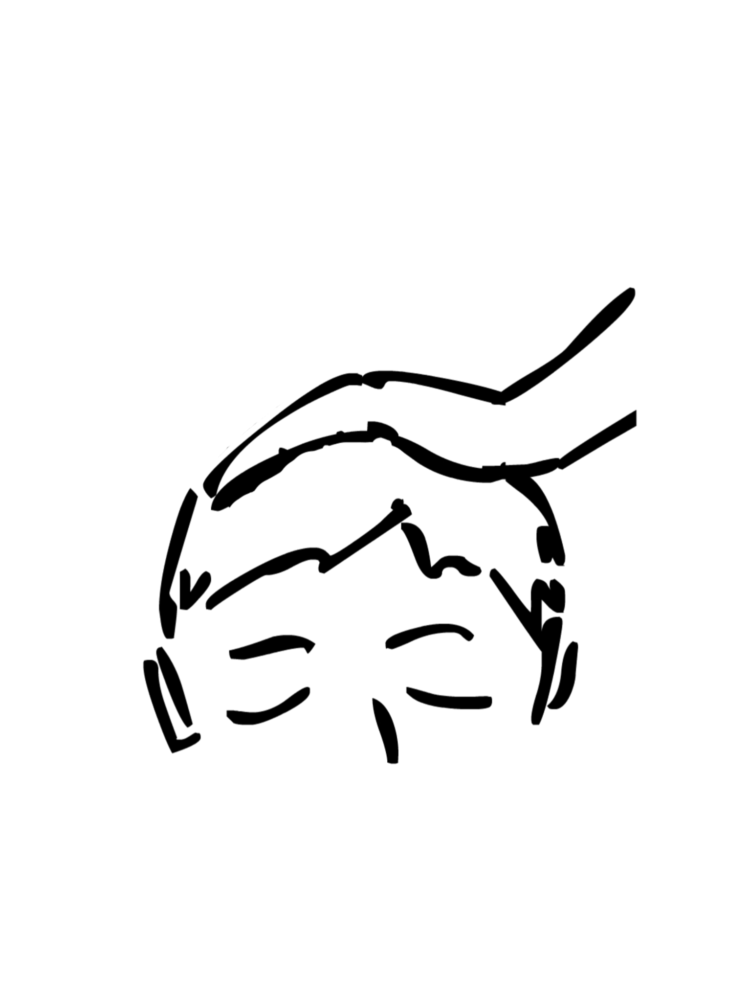
GIVING OF COMMUNION
PRAYER AFTER COMMUNION
The post communion prayer followed by...
All Almighty God,
we thank you for feeding us
with the body and blood of your Son Jesus Christ.
Through him we offer you our souls and bodies
to be a living sacrifice.
Send us out in the power of your Spirit
to live and work to your praise and glory.
Amen.

Slide 79
THE DISMISSAL
The Lord be with you
All and also with you.
The peace of God,
which passes all understanding,
keep your hearts and minds
in the knowledge and love of God,
and of his Son Jesus Christ our Lord;
and the blessing of God almighty,
the Father, the Son, and the Holy Spirit,
be among you and remain with you always.
All Amen.
Go in peace to love and serve the Lord.
All In the name of Christ. Amen.

Slide 81
COMMUNION
Ordinary Time
CHAPEL OF EASE
NORTHEND

Slide 82
THE GATHERING
HYMN
In the name of the Father,
and of the Son,
and of the Holy Spirit.
All Amen.
THE GREETING
Grace, mercy and peace
from God our Father
and the Lord Jesus Christ
be with you.
All and also with you.

Slide 83
PRAYER OF PREPARATION
All Almighty God,
to whom all hearts are open,
all desires known,
and from whom no secrets are hidden:
cleanse the thoughts of our hearts
by the inspiration of your Holy Spirit,
that we may perfectly love you,
and worthily magnify your holy name;
through Christ our Lord.
Amen.
PRAYERS OF PENITENCE
God so loved the world
that he gave his only Son Jesus Christ
to save us from our sins,
to be our advocate in heaven,
and to bring us to eternal life.
Let us confess our sins in penitence and faith,
firmly resolved to keep God's commandments
and to live in love and peace with all.

Slide 84
All Almighty God, our heavenly Father,
we have sinned against you
and against our neighbour
in thought and word and deed,
through negligence, through weakness,
through our own deliberate fault.
We are truly sorry
and repent of all our sins.
For the sake of your Son Jesus Christ,
who died for us,
forgive us all that is past
and grant that we may serve you
in newness of life
to the glory of your name. Amen.
Almighty God,
who forgives all who truly repent,
have mercy upon you,
pardon and deliver you from all your sins,
confirm and strengthen you in all goodness,
and keep you in life eternal;
through Jesus Christ our Lord.
All Amen.

Slide 85
THE GLORIA
All Glory to God in the highest,
and peace to his people on earth.
Lord God, heavenly King,
almighty God and Father,
we worship you, we give you thanks,
we praise you for your glory.
Lord Jesus Christ, only Son of the Father,
Lord God, Lamb of God,
you take away the sin of the world:
have mercy on us;
you are seated at the right hand of the Father:
receive our prayer.
For you alone are the Holy One,
you alone are the Lord,
you alone are the Most High, Jesus Christ,
with the Holy Spirit,
in the glory of God the Father.
Amen.
THE COLLECT
All Amen.

Slide 86
The LITURGY OF THE WORD
A READING FROM THE BIBLE
This is the word of the Lord.
All Thanks be to God.
HYMN
GOSPEL READING
The Lord be with you
All and also with you.
Hear the Gospel of our Lord Jesus Christ according to N.
All Glory to you, O Lord.
At the end of the Gospel
This is the Gospel of the Lord.
All Praise to you, O Christ.
SERMON

Slide 87
THE CREED
All I believe in God, the Father almighty,
creator of heaven and earth.
I believe in Jesus Christ, his only Son, our Lord,
who was conceived by the Holy Spirit,
born of the Virgin Mary,
suffered under Pontius Pilate,
was crucified, died, and was buried;
he descended to the dead.
On the third day he rose again;
he ascended into heaven,
he is seated at the right hand of the Father,
and he will come to judge the living and the dead.
I believe in the Holy Spirit, the holy catholic Church,
the communion of saints, the forgiveness of sins,
the resurrection of the body, and the life everlasting. Amen.
PRAYERS OF INTERCESSION
At the end of each section, the response is...
Lord, in your mercy
All hear our prayer.
The prayers conclude with the following:
Merciful Father,
All accept these prayers
for the sake of your Son,
our Saviour Jesus Christ. Amen.

Slide 88
The Liturgy of the Sacrament
Please stand
THE PEACE
The peace of the Lord be always with you
All and also with you.
Let us offer one another a sign of peace.
HYMN
THE PREPARATION OF THE TABLE AND OFFERTORY
God of grace,
your limitless love gave us everything in Jesus,
and through belief in him,
you offer us life in your kingdom.
Accept our gifts, but as we give,
warm and soften our hearts
to lead us into lives which reflect your generosity. Change us we pray.
All Amen.

Slide 89
THE EUCHARISTIC PRAYER
The Lord be with you
All and also with you.
Lift up your hearts.
All We lift them to the Lord.
Let us give thanks to the Lord our God.
All It is right to give thanks and praise.
It is indeed right, it is our duty and our joy,
at all times and in all places
to give you thanks and praise,
holy Father, heavenly King,
almighty and eternal God,
through Jesus Christ your Son our Lord.
For he is your living Word;
through him you have created all things from the beginning,
and formed us in your own image.
Through him you have freed us from the slavery of sin,
giving him to be born of a woman and to die upon the cross;
you raised him from the dead
and exalted him to your right hand on high.
Through him you have sent upon us
your holy and life-giving Spirit,
and made us a people for your own possession.

Slide 90
Therefore with angels and archangels,
and with all the company of heaven,
we proclaim your great and glorious name,
for ever praising you and saying:
All Holy, holy, holy Lord,
God of power and might,
heaven and earth are full of your glory.
Hosanna in the highest.
Blessed is he who comes in the name of the Lord.
Hosanna in the highest.
Accept our praises, heavenly Father,
through your Son our Saviour Jesus Christ,
and as we follow his example and obey his command,
grant that by the power of your Holy Spirit
these gifts of bread and wine
may be to us his body and his blood;
who, in the same night that he was betrayed,
took bread and gave you thanks;
he broke it and gave it to his disciples, saying:
Take, eat; this is my body which is given for you;
do this in remembrance of me.

Slide 91
In the same way, after supper
he took the cup and gave you thanks;
he gave it to them, saying:
Drink this, all of you;
this is my blood of the new covenant,
which is shed for you and for many
for the forgiveness of sins.
Do this, as often as you drink it,
in remembrance of me.
Therefore, heavenly Father,
we remember his offering of himself
made once for all upon the cross;
we proclaim his mighty resurrection
and glorious ascension;
we look for the coming of your kingdom,
and with this bread and this cup
we make the memorial of Christ your Son our Lord.
Great is the mystery of faith:
All Christ has died:
Christ is risen:
Christ will come again.

Slide 92
Accept through him, our great high priest,
this our sacrifice of thanks and praise,
and as we eat and drink these holy gifts
in the presence of your divine majesty,
renew us by your Spirit,
inspire us with your love
and unite us in the body of your Son,
Jesus Christ our Lord.
Through him, and with him, and in him,
in the unity of the Holy Spirit,
with all who stand before you in earth and heaven,
we worship you, Father almighty,
in songs of everlasting praise:
All Blessing and honour and glory and power
be yours for ever and ever. Amen.

Slide 93
THE LORDS PRAYER
Let us pray with confidence as our Saviour has taught us
All Our Father, who art in heaven,
hallowed be thy name;
thy kingdom come; thy will be done;
on earth as it is in heaven.
Give us this day our daily bread.
And forgive us our trespasses,
as we forgive those who trespass against us.
And lead us not into temptation;
but deliver us from evil.
For thine is the kingdom,
the power and the glory,
for ever and ever. Amen.
BREAKING OF THE BREAD
We break this bread
to share in the body of Christ.
All Though we are many, we are one body,
because we all share in one bread.

Slide 94
All Lamb of God,
you take away the sin of the world,
have mercy on us.
Lamb of God,
you take away the sin of the world,
have mercy on us.
Lamb of God,
you take away the sin of the world,
grant us peace.
INVITATION TO COMMUNION
Draw near with faith.
Receive the body of our Lord Jesus Christ
which he gave for you,
and his blood which he shed for you.
Eat and drink in remembrance that he died for you,
and feed on him in your hearts
by faith with thanksgiving.
Jesus is the Lamb of God
who takes away the sin of the world.
Blessed are those who are called to his supper.
All Lord, I am not worthy to receive you,
but only say the word, and I shall be healed.

Slide 95
GIVING OF COMMUNION
PRAYER AFTER COMMUNION
The post communion prayer followed by...
All Almighty God,
we thank you for feeding us
with the body and blood of your Son Jesus Christ.
Through him we offer you our souls and bodies
to be a living sacrifice.
Send us out in the power of your Spirit
to live and work to your praise and glory.
Amen.

Slide 96
THE DISMISSAL
The Lord be with you
All and also with you.
The peace of God,
which passes all understanding,
keep your hearts and minds
in the knowledge and love of God,
and of his Son Jesus Christ our Lord;
and the blessing of God almighty,
the Father, the Son, and the Holy Spirit,
be among you and remain with you always.
All Amen.
Go in peace to love and serve the Lord.
All In the name of Christ. Amen.

