Slide 1
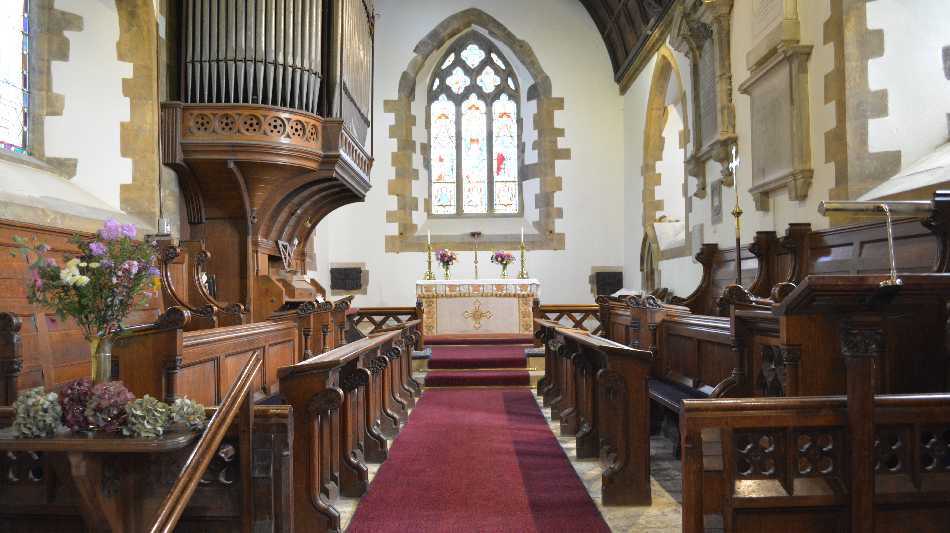
WEDNESDAY
MORNING PRAYER
ST. BOTOLPH
FARNBOROUGH

Slide 2
O Lord, open our lips.
All and our mouth shall proclaim your praise.
Reveal among us the light of your presence
All that we may behold your power and glory.
Blessed are you, Sovereign God of all,
to you be praise and glory for ever.
In your tender compassion
the dawn from on high is breaking upon us
to dispel the lingering shadows of night.
As we look for your coming among us this day,
open our eyes to behold your presence
and strengthen our hands to do your will,
that the world may rejoice and give you praise.
Blessed be God, Father, Son and Holy Spirit.
All Blessed be God for ever.
from Psalm 98

Slide 3
The night has passed, and the day lies open before us;
let us pray with one heart and mind.
Silence is kept
As we rejoice in the gift of this new day,
so may the light of your presence, O God,
set our hearts on fire with love for you;
now and for ever.
All Amen.
THE WORD OF GOD Psalm refrain is read...
All Glory to the Father and to the Son
and to the Holy Spirit
as it was in the beginning
is now and shall be for ever. Amen
Thus says our God, I will comfort you,
you shall see and your heart shall rejoice.

Slide 4
BIBLE READING
Open my eyes, O Lord
that I may see the wonders of your law.
All Open my eyes, O Lord
that I may see the wonders of your law.
Lead me in the path of your commandments
All that I may see the wonders of your law.
Glory to the Father and to the Son and to the Holy Spirit.
All Open my eyes, O Lord
that I may see the wonders of your law.
from Psalm 119
BIBLE REFLECTION
Almighty God, we thank you for the gift of your holy word.
May it be a lantern to our feet, a light upon our paths,
and a strength to our lives.

Slide 5
Blessed be the Lord the God of Israel,
who has come to his people and set them free.
All He has raised up for us a mighty Saviour,
born of the house of his servant David.
Through his holy prophets God promised of old
to save us from our enemies,
from the hands of all that hate us,
All To show mercy to our ancestors,
and to remember his holy covenant.
This was the oath God swore to our father Abraham:
to set us free from the hands of our enemies,
All Free to worship him without fear,
holy and righteous in his sight
all the days of our life.
And you, child, shall be called the prophet of the Most High,
for you will go before the Lord to prepare his way,
All To give his people knowledge of salvation
by the forgiveness of all their sins.
In the tender compassion of our God
the dawn from on high shall break upon us,
All To shine on those who dwell in darkness and the shadow of death,
and to guide our feet into the way of peace. Luke 1:68-79

Slide 6
All Glory to the Father and to the Son
and to the Holy Spirit;
as it was in the beginning is now
and shall be for ever. Amen.
The Lord has anointed me
and sent me to bring good news to the oppressed.
PRAYERS OF INTERCESSION
Lord, in your mercy
All hear our prayer
We pray for those who have asked for prayers, those who have not but need them and those that care for or worry about them.
PRAYER LIST - leader click picture to go to…
We now have a moment of silent prayer to bring to the Lord
those people and things on our hearts and mind.
Silence
Lord, in your mercy
All hear our prayer

Slide 7
Welcome, O Lord, into the joy and peace of your kingdom
those who have departed out of this life to be with you.
Mercifully grant them a place with the spirits of the just;
and give them the life that knows not age,
the reward that passes not away;
We commend to you the soul of…
Leader refer to own list of names
In your boundless compassion console those who mourn;
and give us faith to see in death the gate of eternal life,
so that in quiet confidence we may continue our course on earth,
until, by your call, we are reunited with those who have gone before;
Take under your loving wing...
Lord, in your mercy
All hear our prayer

Slide 8
Welcome, O Lord, into the joy and peace of your kingdom
those who have departed out of this life to be with you.
Mercifully grant them a place with the spirits of the just;
and give them the life that knows not age,
the reward that passes not away;
We commend to you the soul of...
In your boundless compassion console those who mourn;
and give us faith to see in death the gate of eternal life,
so that in quiet confidence we may continue our course on earth,
until, by your call, we are reunited with those who have gone before;
Take under your loving wing...
We now have a moment of silent prayer to bring to the Lord
those people and things on our hearts and mind.
Silence
Lord, in your mercy
All hear our prayer

Slide 9
We pray for all in our communities
especially remembering today those who live and work in...
MONDAY Northend, Temple Herdewyke & Kineton Station
TUESDAY Burton Dassett, Little Dassett & Knightcote
WEDNESDAY Farnborough
THURSDAY Fenny Compton and Avon Dassett
FRIDAY Gaydon & Chadshunt
We commend ourselves, and all for whom we pray,
to the mercy and protection of God.
All Merciful Father,
accept these prayers
for the sake of your Son,
our Saviour Jesus Christ. Amen.
THE COLLECT FOR THE DAY
All Amen.

Slide 10
THE LORDS PRAYER
Trusting in the compassion of God,
let us pray with confidence as our Saviour has taught us
All Our Father, who art in heaven,
hallowed be thy name;
thy kingdom come; thy will be done;
on earth as it is in heaven.
Give us this day our daily bread.
And forgive us our trespasses,
as we forgive those who trespass against us.
And lead us not into temptation;
but deliver us from evil.
For thine is the kingdom, the power and the glory,
for ever and ever. Amen.
Let us bless the Lord.
All Thanks be to God.

